Slide 1
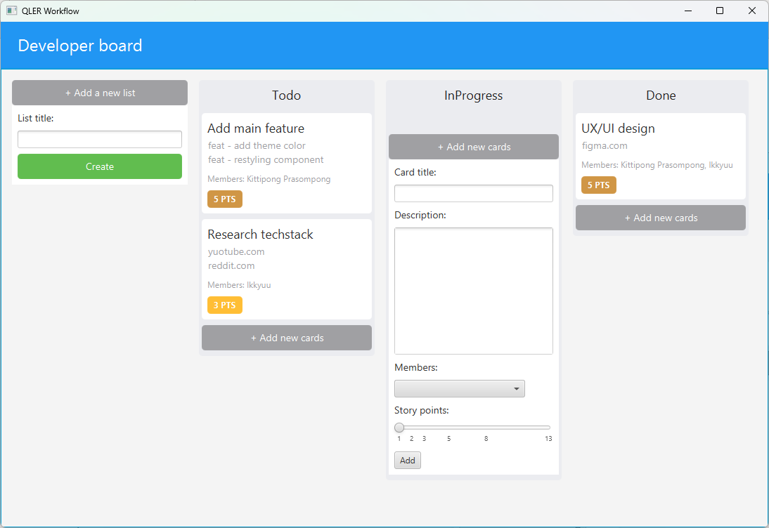
QLER Workflow: Streamlining Trello-Inspired List Creation
Introduction Design Concept Class Diagram Algorithms Installation and Usage Conclusion

Slide 2
Introduction I am Kittipong Prasompong, a first-year Engineering Computer student at Kasetsart University Sriracha campus. My project, QLER Workflow, was inspired by Trello.com. I had trouble creating new lists and sought to improve the process with a more user-friendly interface. This project used JavaFX and ControlFX to create a unique design and implementation. I will explain the design, class diagram, algorithms, installation, and usage of QLER Workflow during the presentation
Introduction Design Concept Class Diagram Algorithms Installation and Usage Conclusion

Slide 3
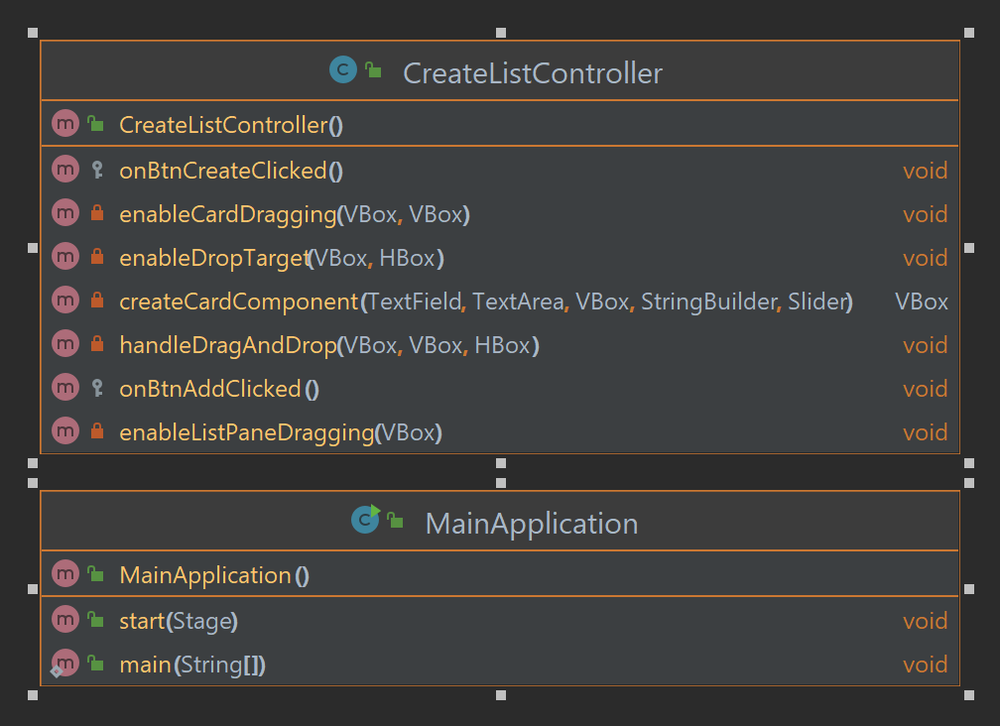

Introduction I am Kittipong Prasompong, a first-year Engineering Computer student at Kasetsart University Sriracha campus. My project, QLER Workflow, was inspired by Trello.com. I had trouble creating new lists and sought to improve the process with a more user-friendly interface. This project used JavaFX and ControlFX to create a unique design and implementation. I will explain the design, class diagram, algorithms, installation, and usage of QLER Workflow during the presentation
Design Concept The primary goal of QLER Workflow was to create a more user-friendly interface compared to Trello. To achieve this, I reduced unnecessary features and focused on simplifying the process of creating new lists. The UI was designed to be clean and easy to navigate, with a simple drag-and-drop feature for moving tasks between lists.
Introduction Design Concept Class Diagram Algorithms Installation and Usage Conclusion

Slide 4
Design Concept The primary goal of QLER Workflow was to create a more user-friendly interface compared to Trello. To achieve this, I reduced unnecessary features and focused on simplifying the process of creating new lists. The UI was designed to be clean and easy to navigate, with a simple drag-and-drop feature for moving tasks between lists.
Class Diagram
The class diagram for QLER Workflow includes two main classes: MainApplication, and CreateListController. the CreateListController class represents each individual list and cards within the project. The relationships between the classes are also clearly defined, ensuring smooth communication between them.

Slide 5

Algorithms
The algorithms used by QLER Workflow help to organize tasks and improve workflow efficiency by creating and managing lists and cards, and by providing drag and drop functionality.
The algorithms are designed to be intuitive and easy to use, allowing users to quickly and effectively create and manage lists, cards, and tasks with minimal effort.
Class Diagram
The class diagram for QLER Workflow includes two main classes: MainApplication, and CreateListController. the CreateListController class represents each individual list and cards within the project. The relationships between the classes are also clearly defined, ensuring smooth communication between them.

Slide 6
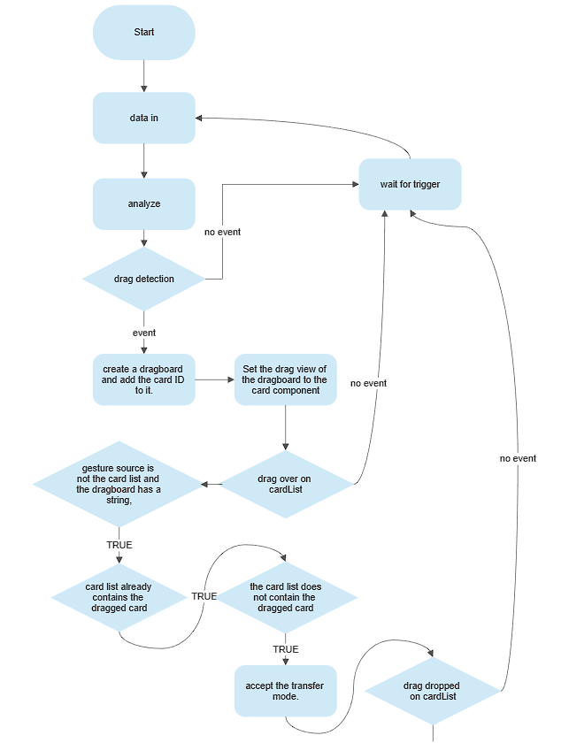
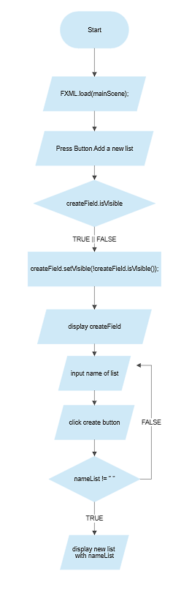
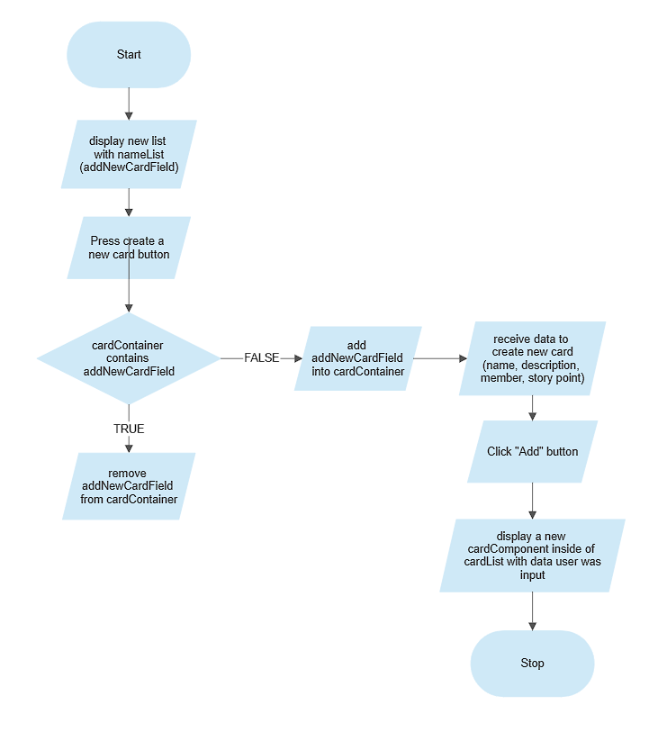
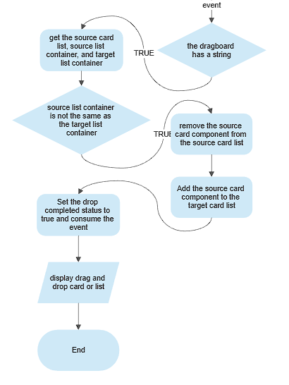
Class Diagram
The class diagram for QLER Workflow includes two main classes: MainApplication, and CreateListController. the CreateListController class represents each individual list and cards within the project. The relationships between the classes are also clearly defined, ensuring smooth communication between them.
Algorithms
The algorithms used by QLER Workflow help to organize tasks and improve workflow efficiency by creating and managing lists and cards, and by providing drag and drop functionality.
The algorithms are designed to be intuitive and easy to use, allowing users to quickly and effectively create and manage lists, cards, and tasks with minimal effort.

Slide 7
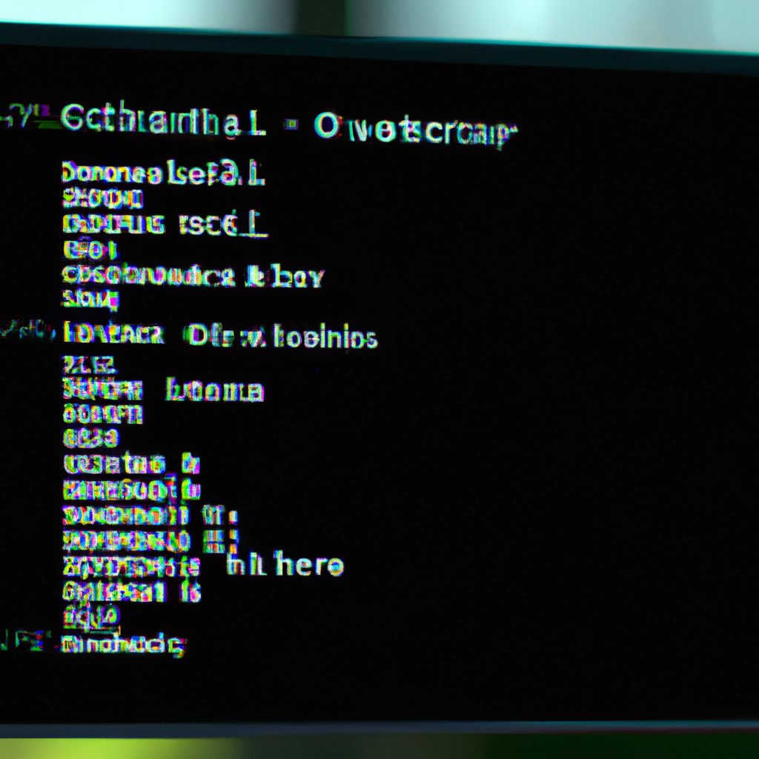
Installation and Usage
QLER Workflow may be installed and employed through cloning a repository from Github and exploiting a terminal.
This technique enables individuals to expeditiously oversee their operational procedures and amalgamate with others in the enterprise.
Class Diagram
The class diagram for QLER Workflow includes two main classes: MainApplication, and CreateListController. the CreateListController class represents each individual list and cards within the project. The relationships between the classes are also clearly defined, ensuring smooth communication between them.

Slide 8
Installation and Usage
QLER Workflow may be installed and employed through cloning a repository from Github and exploiting a terminal.
This technique enables individuals to expeditiously oversee their operational procedures and amalgamate with others in the enterprise.

Slide 9
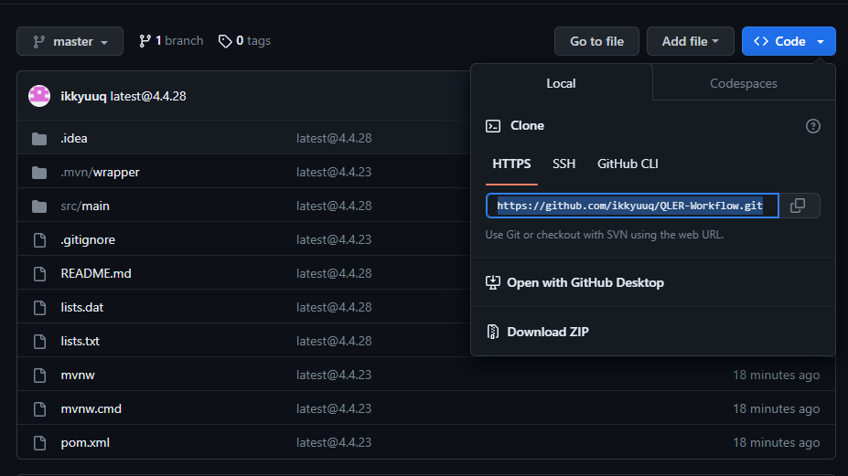
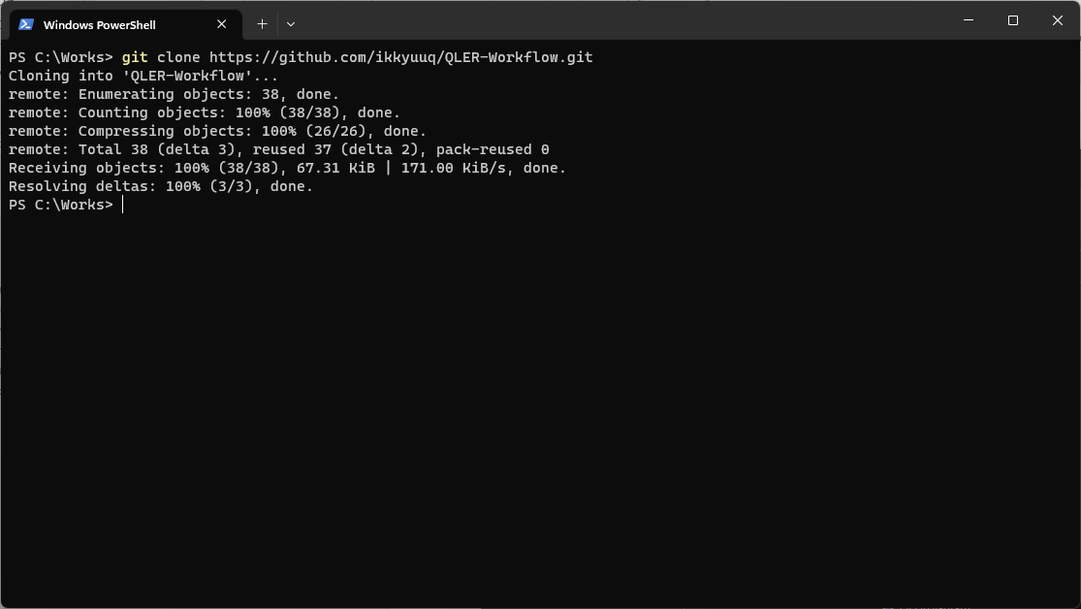
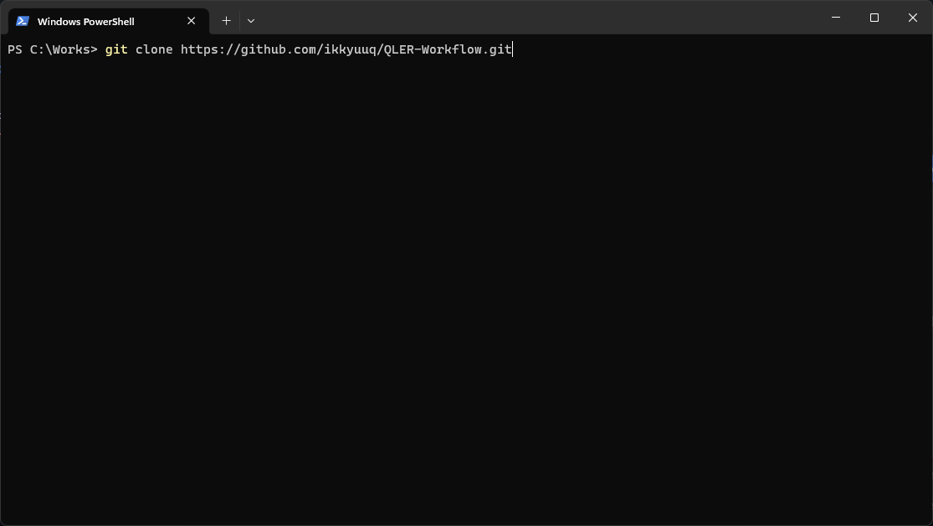
Installation and Usage
QLER Workflow may be installed and employed through cloning a repository from Github and exploiting a terminal.
This technique enables individuals to expeditiously oversee their operational procedures and amalgamate with others in the enterprise.
We will copy the highlighted link to clone.

Slide 10
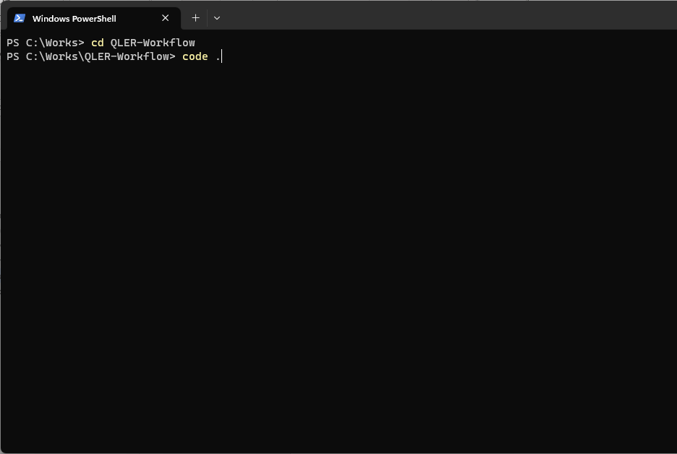
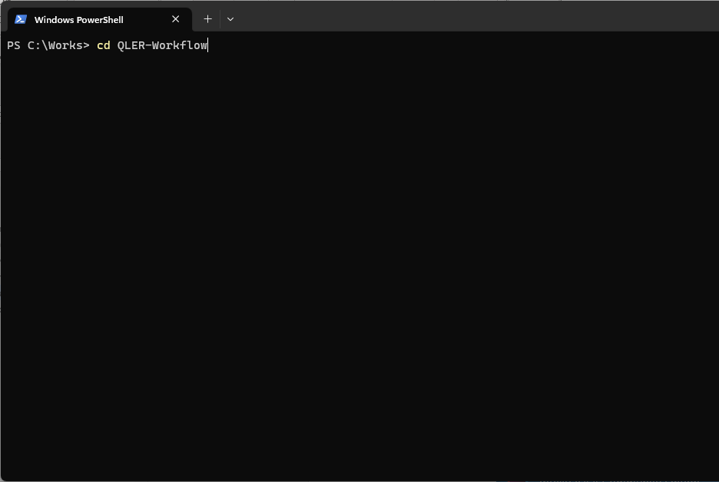
Installation and Usage
QLER Workflow may be installed and employed through cloning a repository from Github and exploiting a terminal.
This technique enables individuals to expeditiously oversee their operational procedures and amalgamate with others in the enterprise.
We will open Terminal and enter the command
git clone <repourl>
git clone https://github.com/ikkyuuq/QLER-Workflow.git

Slide 11
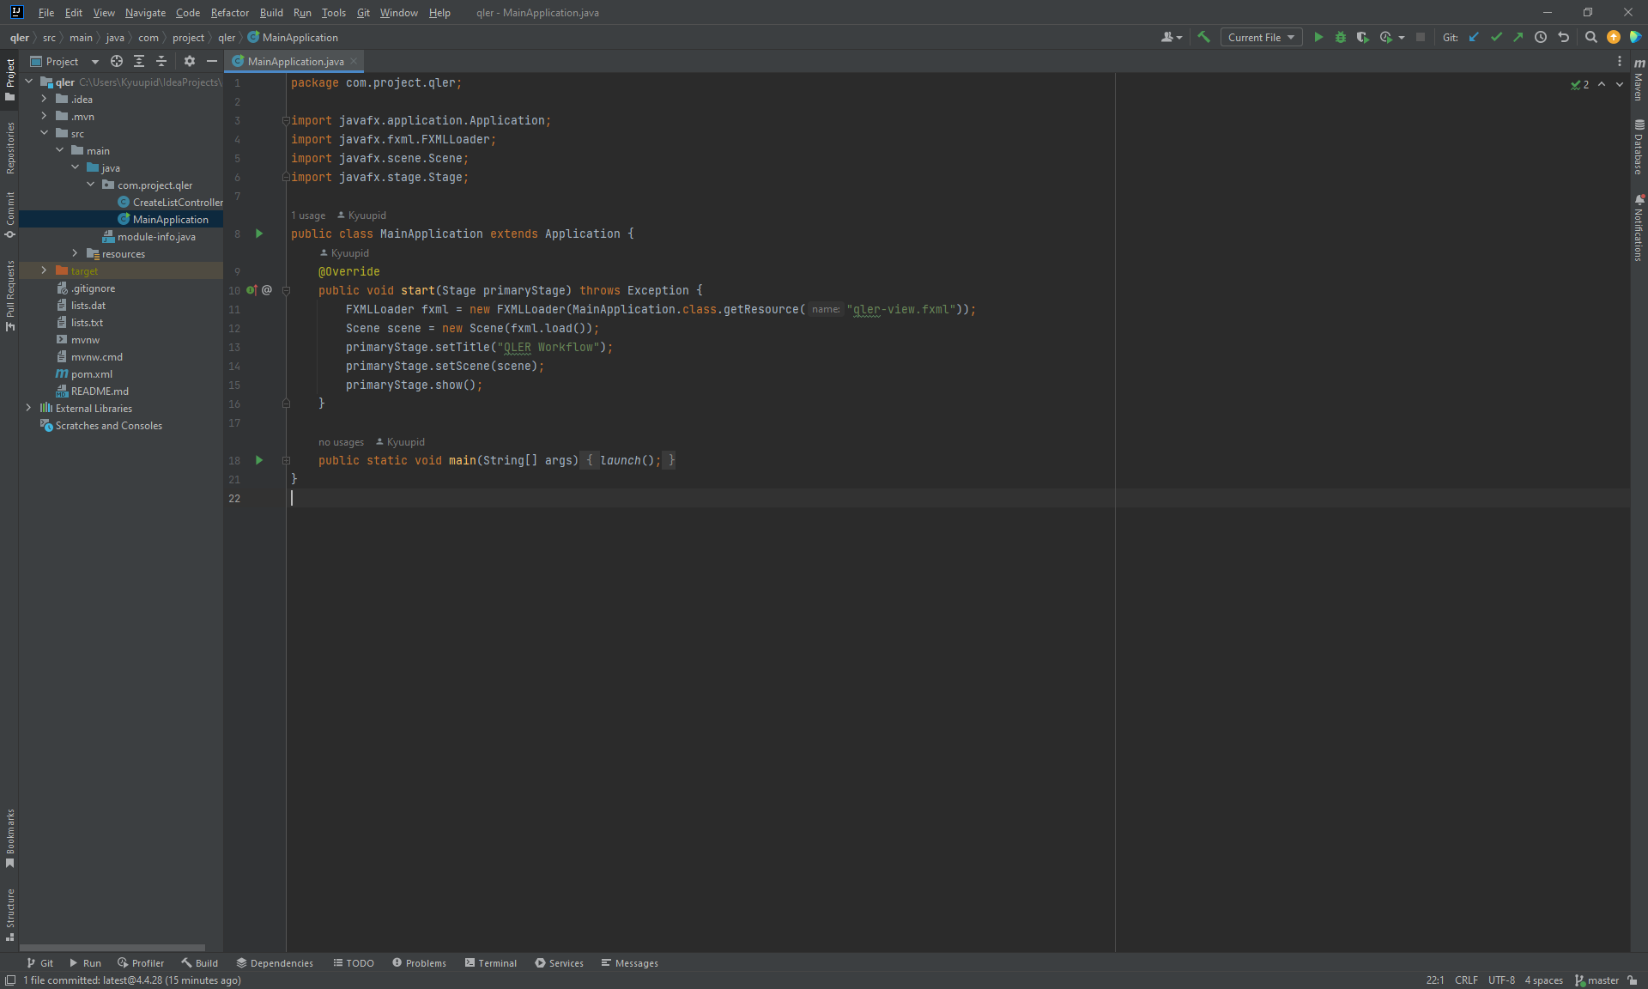
Installation and Usage
QLER Workflow may be installed and employed through cloning a repository from Github and exploiting a terminal.
This technique enables individuals to expeditiously oversee their operational procedures and amalgamate with others in the enterprise.
Then we will go to the QLER-Workflow directory we just clone into our local machine and open the IDE by typing the code .
After successfully launching the project, if it is the first time, it is necessary to install the SDK first again for the program to work properly. Then you can press run or Shift + F10 normally.

Slide 12
Then we will go to the QLER-Workflow directory we just clone into our local machine and open the IDE by typing the code .
After successfully launching the project, if it is the first time, it is necessary to install the SDK first again for the program to work properly. Then you can press run or Shift + F10 normally.

Slide 13
THANK YOU

